Slide 1










Slide 2
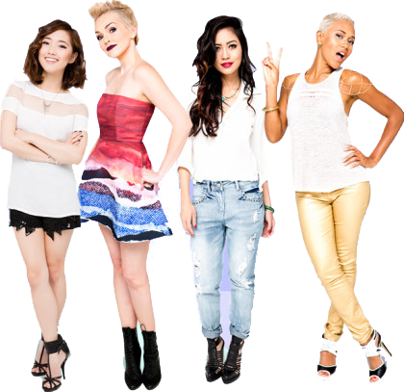
BEAUTYCON
AN ENGAGED AND CONNECTED GLOBAL COMMUNITY OF CONTENT CREATORS, CELEBRITIES, BRANDS AND FANS
Beautycon Festivals | Beautycon Box | Beautycon Media
age
16-24
70%
U.S.
98%
F
BFF
35%
middle
schoolers

Slide 3
CAMPAIGN SUMMARY
Custom wrapped Beautycon boxes
“Beauty and the Beast” make-up inside December boxes
#BeautyBeastChallenge: invite beauty fans to find their inner Belle… or Beast!
“Beauty and the Beast” influencer content + social promos
Beautycon Media social support
“Beauty and the Beast” Trailer pre-roll before Beautycon video content
Beautycon Dallas festival activation - winner of Challenge showcased on stage
Snapchat Story & Facebook Live inclusion at Beautycon Dallas
Winner attends “Beauty and the Beast” premiere
december
january
february
march
1 + 2 + 3
BEAUTYCON BOX
3 + 4 + 5 + 6
BEAUTYCON MEDIA
7 + 8 + 9
BEAUTYCON FESTIVAL

Slide 4
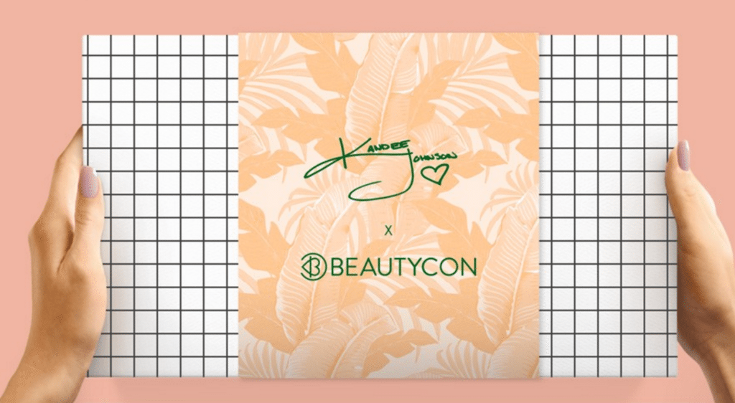
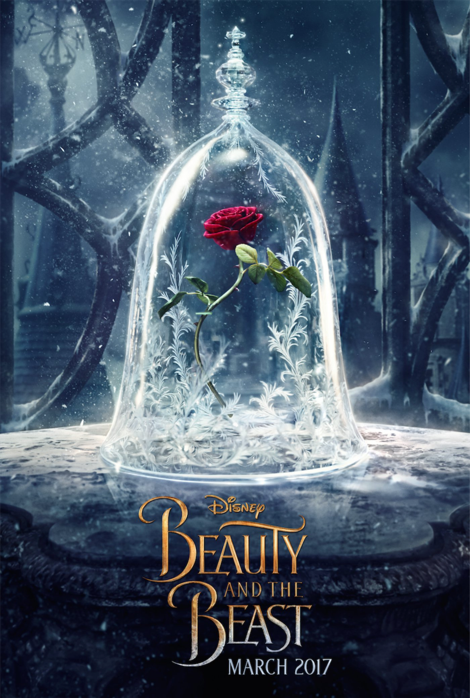

1. BEAUTYCON BOX WRAPPER
The Beautycon box is for anyone who loves all things fashion, beauty, pop culture and lifestyle, and wants to be the FIRST to try out new products.
Generate buzz and excitement over holidays
200,000 units shipped - December 2016
x

Slide 5
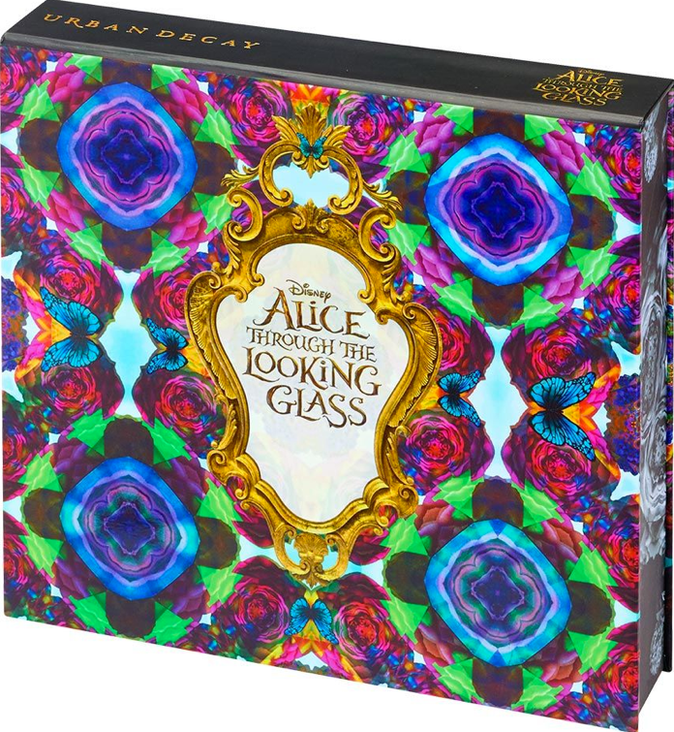
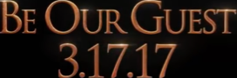

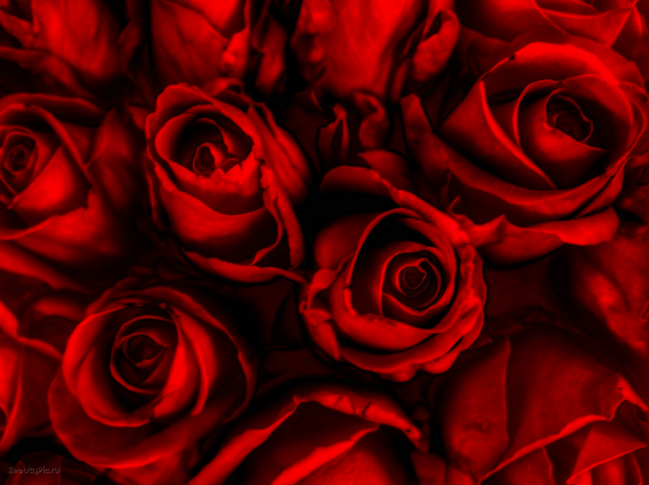
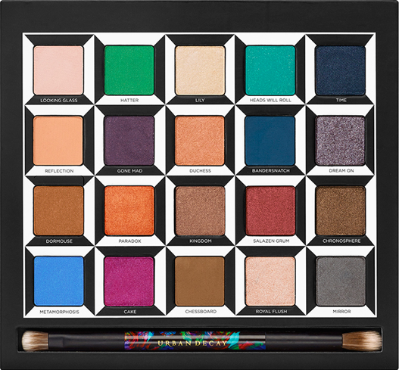

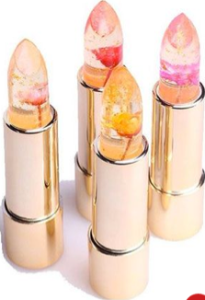
2. “BEAUTY AND THE BEAST” MAKE-UP INSIDE
Special “invite” to movie release
“Beauty and the Beast” branded make-up (i.e. Urban Decay / Alice in Wonderland collaboration)

Slide 6
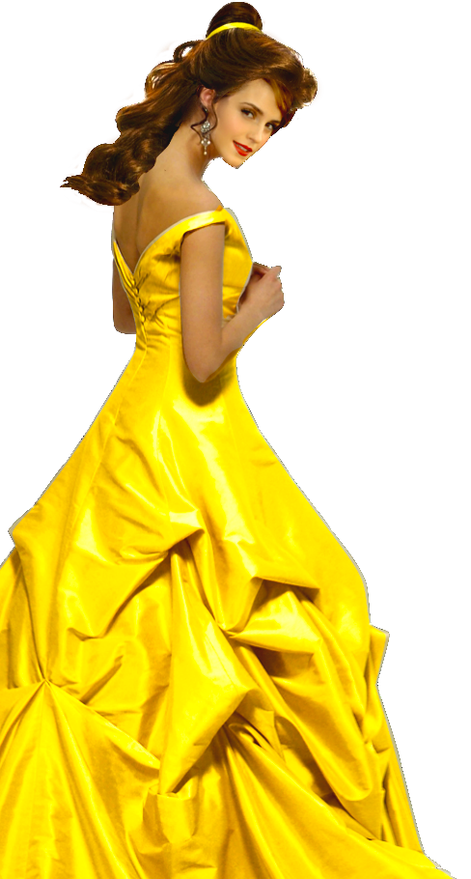
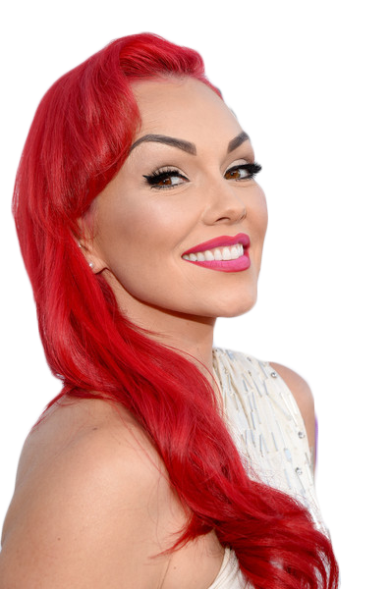
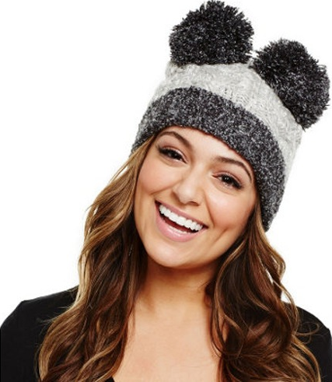
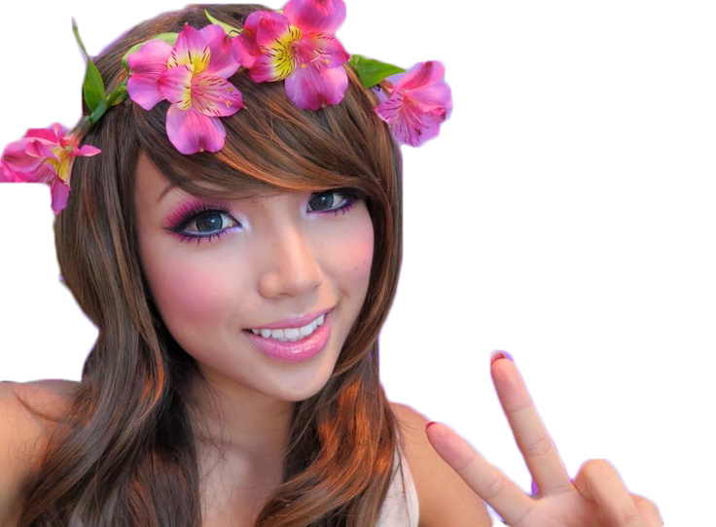
3. BEAUTYCON MEDIA #BEAUTYBEASTCHALLENGE
Beautycon Media provides a large network of diverse content creators who reach hundreds of millions of people in a unique way while creating a viral buzz throughout the digital space.
Beatycon fans invited to “Find Your Inner Belle… or Beast!”
Fans create their best “Beauty and the Beast” content
Post content on social media with #beautybeastchallenge
Winner gets showcased at Beautycon Dallas in March
Winner goes to “Beauty and the Beast” premiere

Slide 7
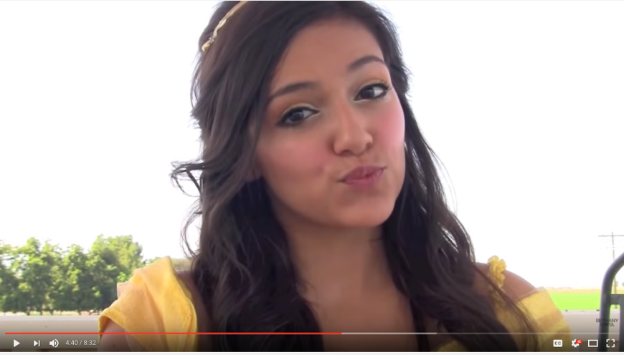
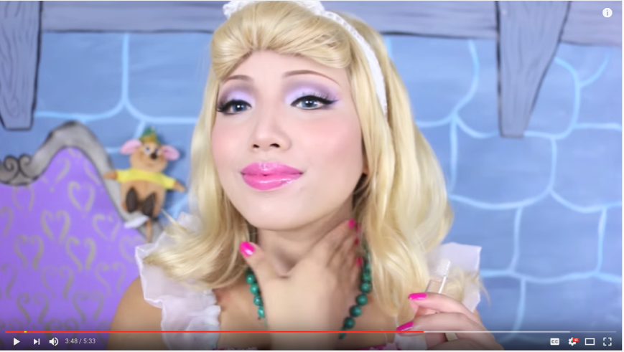
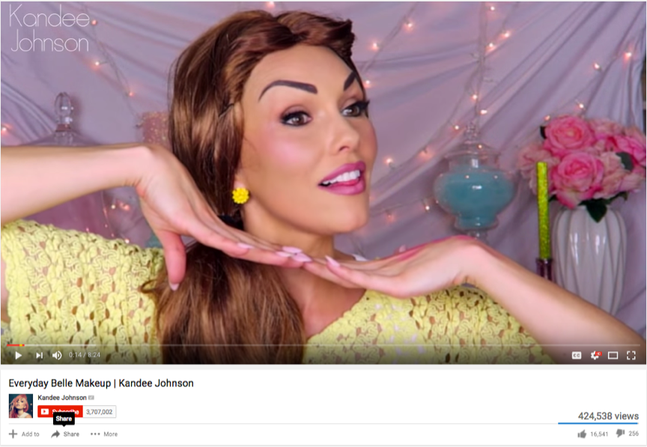
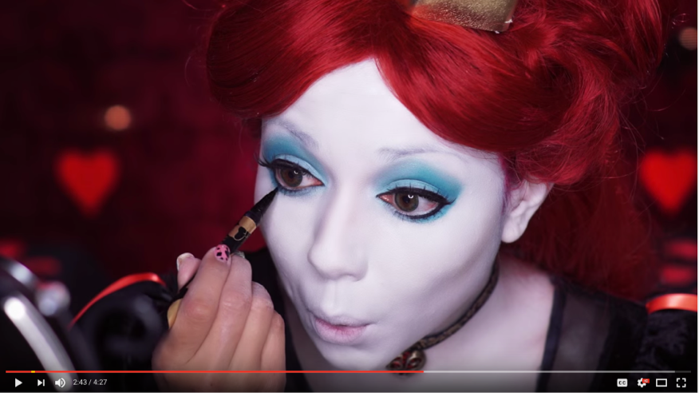
4. BEAUTYCON MEDIA INFLUENCERS KICKOFF CHALLENGE
20 Million video views
22M
7M
Bethany Mota 21.4M+ social footprint
Dope2111 6.7M+ social footprint
7M
1M
Kandee Johnson 6.5M+ social footprint
Charisma Star 1M+ social footprint

Slide 8
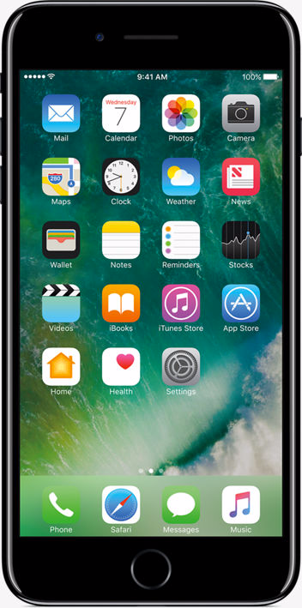
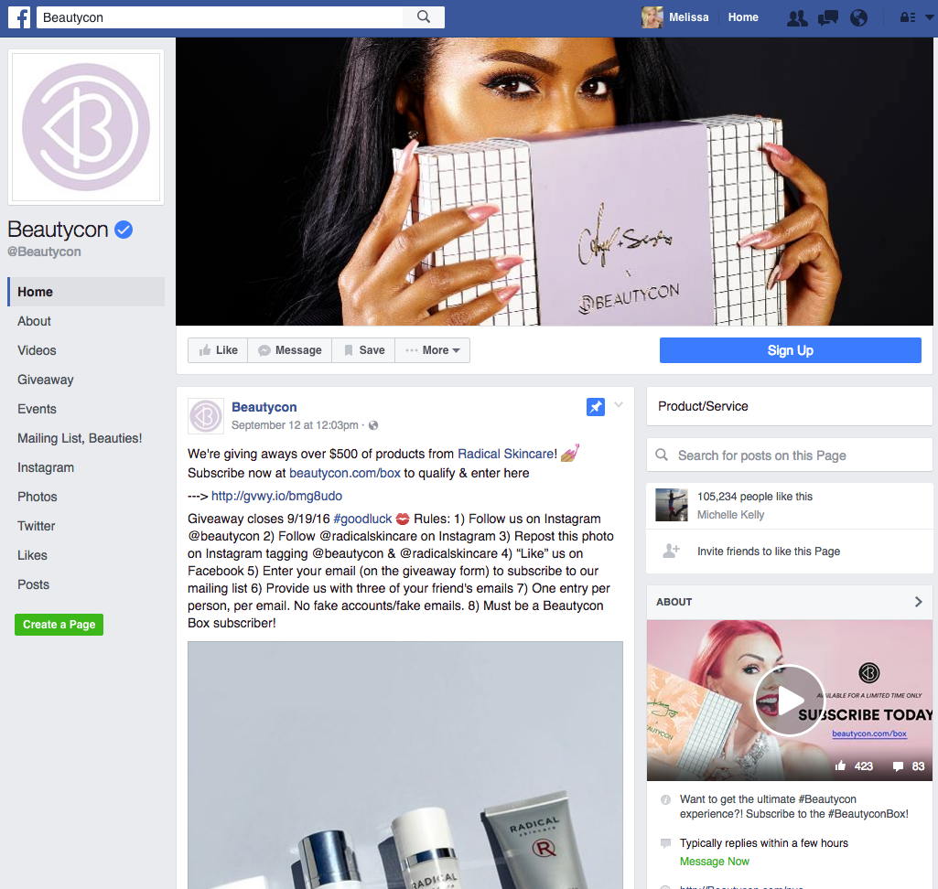
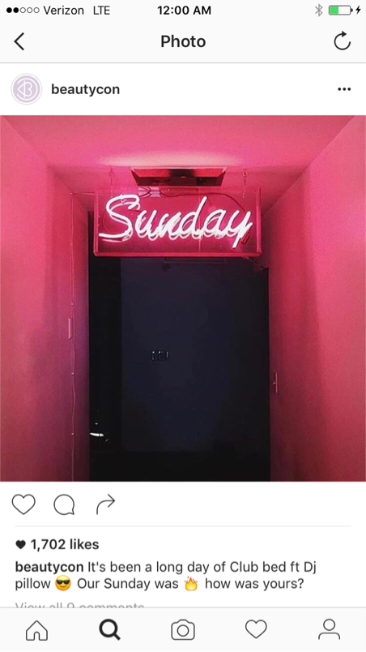
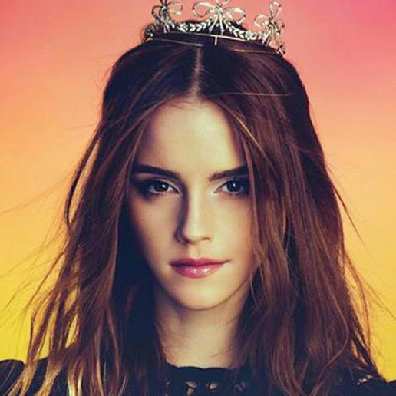

5. BEAUTYCON MEDIA SOCIAL SUPPORT
1.5 Million Impressions
#BeautyBeastChallenge
Find your inner Belle…or Beast! #BeautyBeastChallenge
Winner will get featured on stage at #BeautyCon Dallas in March!
#BeautyBeastChallenge
beautycon Find your inner Belle…or Beast! #BeautyBeastChallenge Winner will get featured on
stage at #BeautyCon Dallas in March!

Slide 9
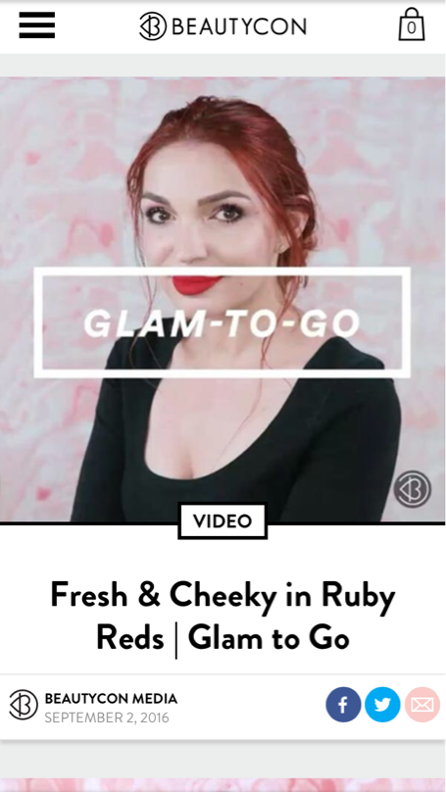
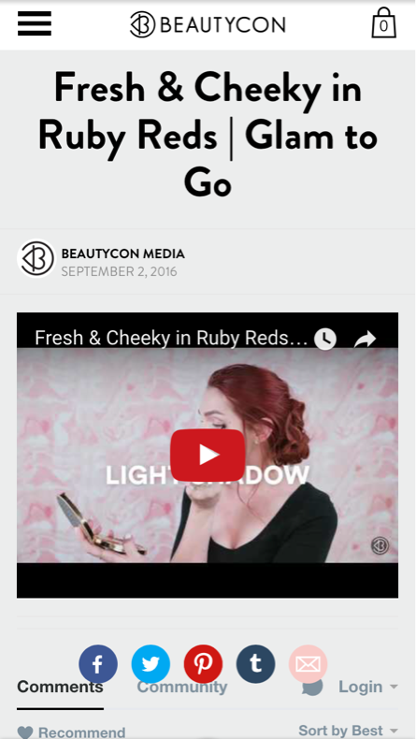

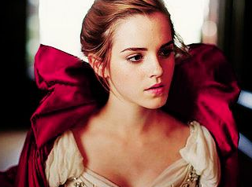

6. BEAUTYCON MEDIA TRAILER PRE-ROLLS
1M impressions
Find your inner
Belle…or Beast!
#BeautyBeastChallenge
Find your inner
Belle…or Beast!
#BeautyBeastChallenge
#BeautyBeastChallenge
#BeautyBeastChallenge
VIDEO
Find your inner
Belle…or Beast!
#BeautyBeastChallenge

Slide 10
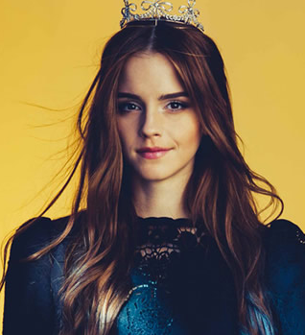
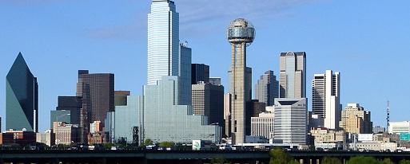
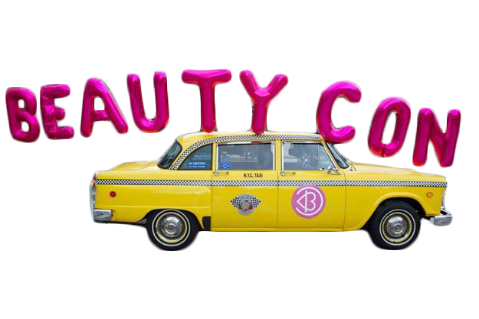
7. BEAUTYCON FESTIVAL DALLAS ACTIVATION
  Trailer shown on stage
  Cast member/s invited to participate on stage, and plug movie
  Winner of #BeautyBeastChallenge showcased on stage
  “Beauty and the Beast” booth (make-up tutorials; Photo Booth w/ Beast, meet & greets w/ challenge winner /movie cast)
  10k+ attendees, most of them teenage girls

Slide 11
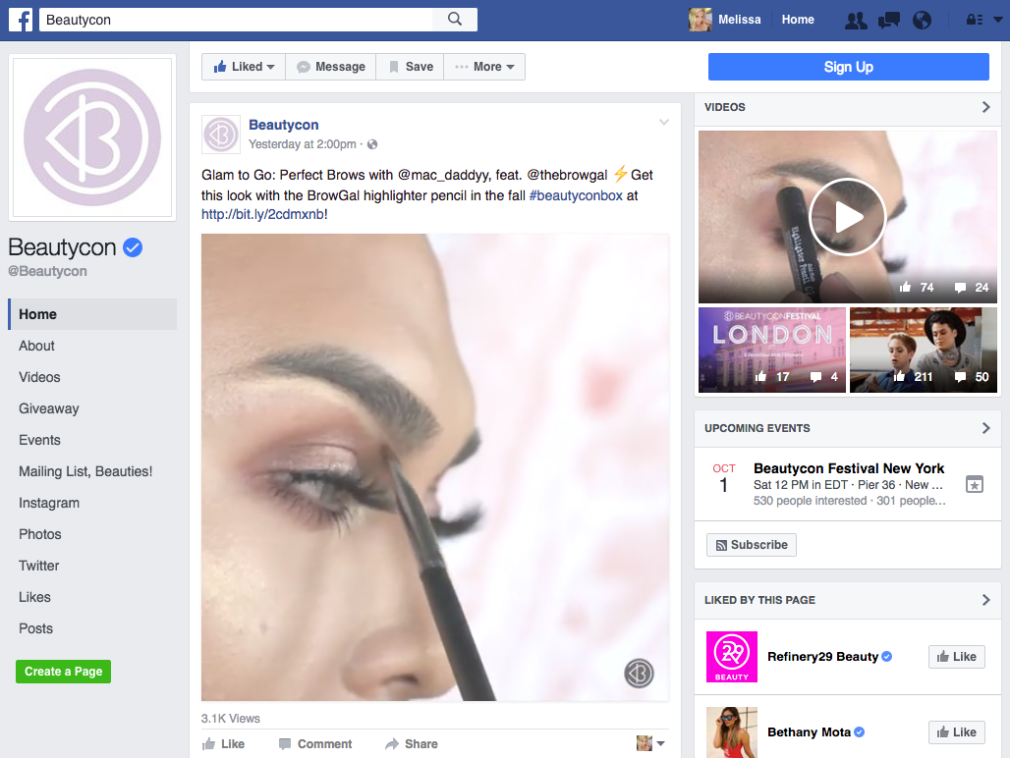
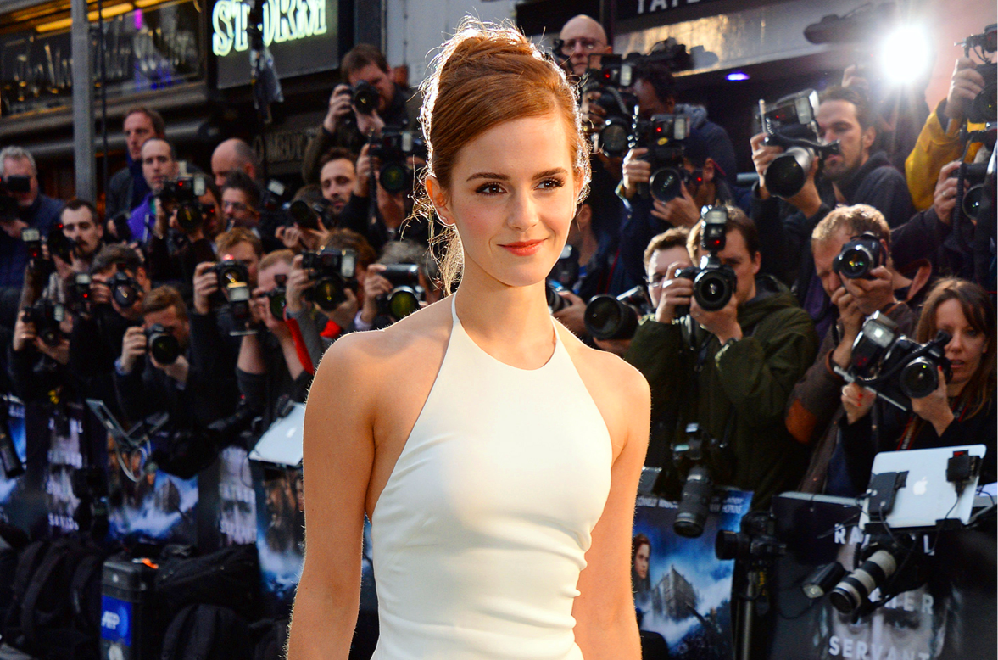
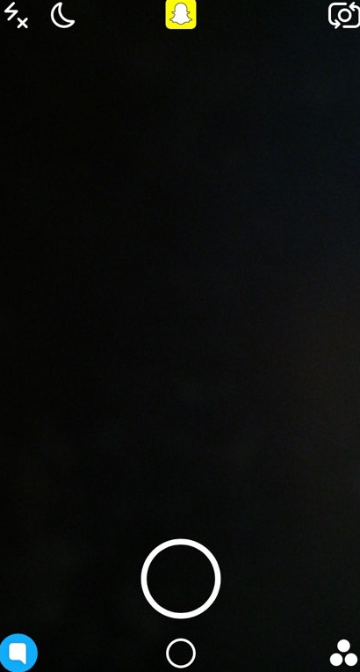
8. BEAUTYCON MEDIA LIVE STREAMING
Snapchat Story Inclusion
Facebook Live Inclusion
#BEAUTYCON
#BEAUTYBEAST
#BeautyBeastChallenge

Slide 12
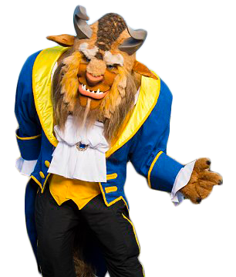



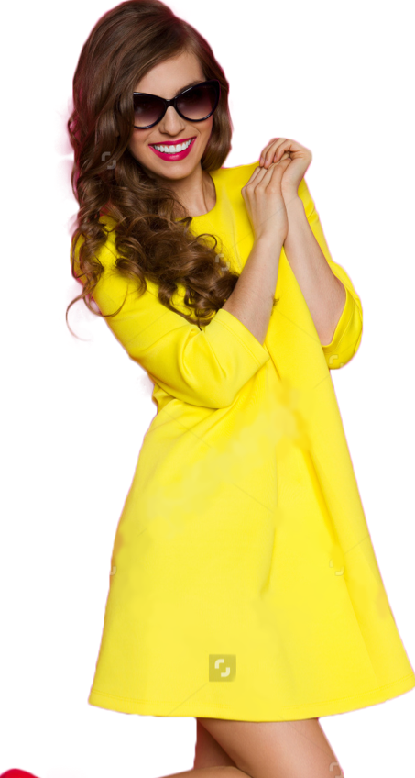





9. WINNER AT BEAUTY AND THE BEAST PREMIERE
Best experience ever!
Thank you #Disney
#BeautyBeastChallenge
#BeautyandtheBeast

Slide 13
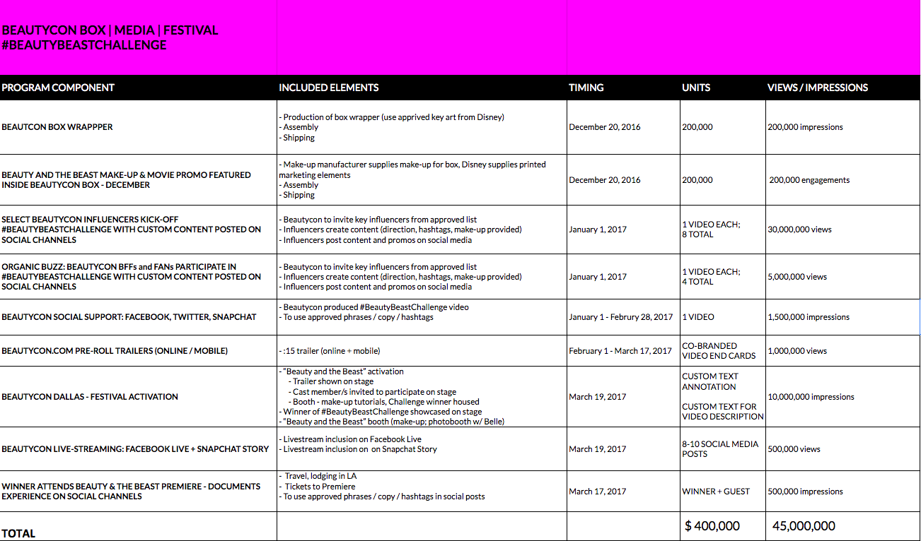
PROPOSAL

Slide 14
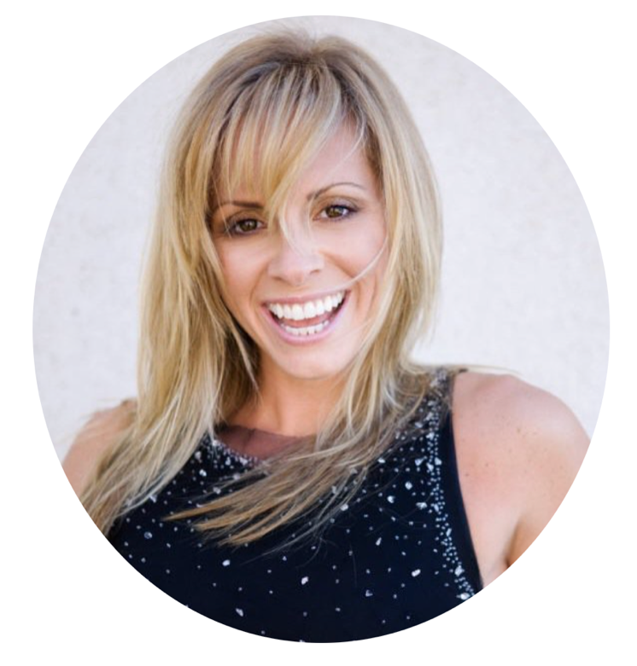
THANK YOU!
melissambowden@gmail.com 310.991.6354

